Slide 1
Land cover map
Jan 31, 2018

Slide 2
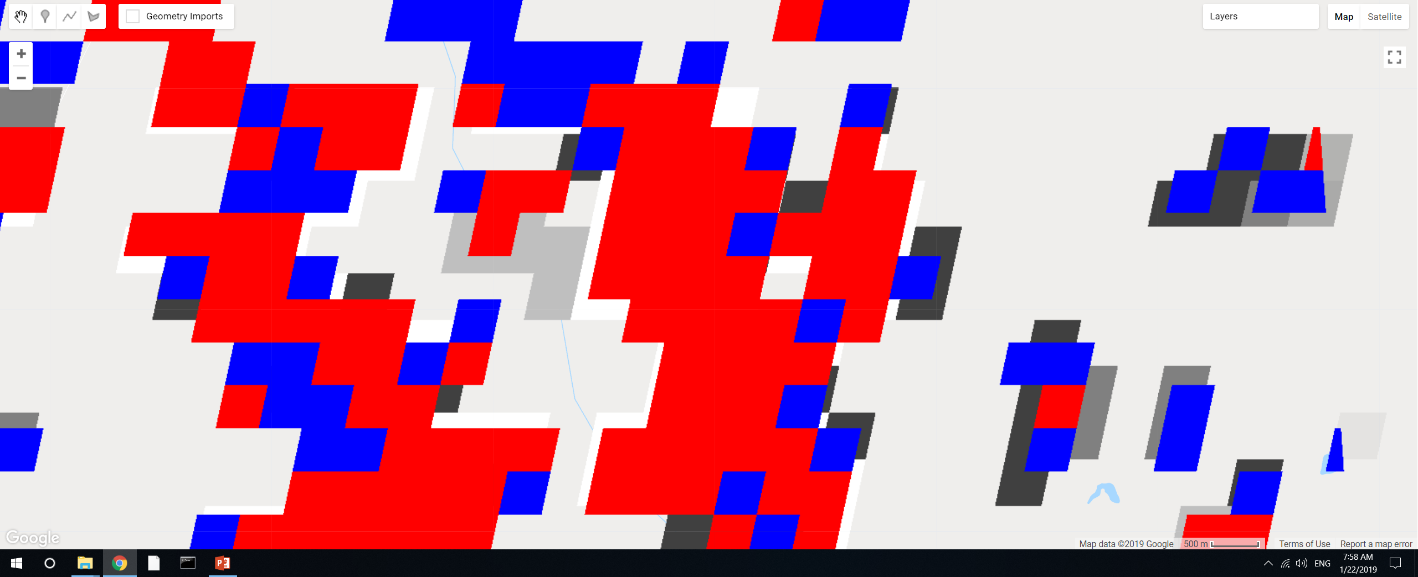
GEE file: LandCover/Soy Classification Masking
Added a small section of code to explore specifics of connectedPixelCount. Red is DC, blue is SC, underlying layer is the ‘count’ from connectedPixelCount, the areas that are not covered by red or blue are class 2 (other agri).
Use 4-connected only. The ‘connection’ is not only for adjacent pixels. So if a ‘red’ pixel is sticking out by itself but it’s connected to a large chunk of ‘red’ pixels, its connected pixels will still be high.
The values of the pixels should be integers. If they’re integers, don’t need to separately mask out DC vs SC; the connected pixels will automatically count only SC or only DC.
If pixels look like they’re only partially masked, it’s probably because they’re masked with a different map. The result of exporting an image should produce whole pixels, though the exact location of the pixels might be mismatched.

Slide 3
Searching for commercial high resolution satellite imagery
Requested quote from Satellite Imaging Corp (QuickBird)
Search for images on LandInfo. Available images to search are:
GeoEye-1
WorldView-1, to -4
QuickBird
IKONOS
SPOT 1- 7
RapidEye
PlaneteScope/Dove
Planet Labs satellites: which ones?

Slide 4
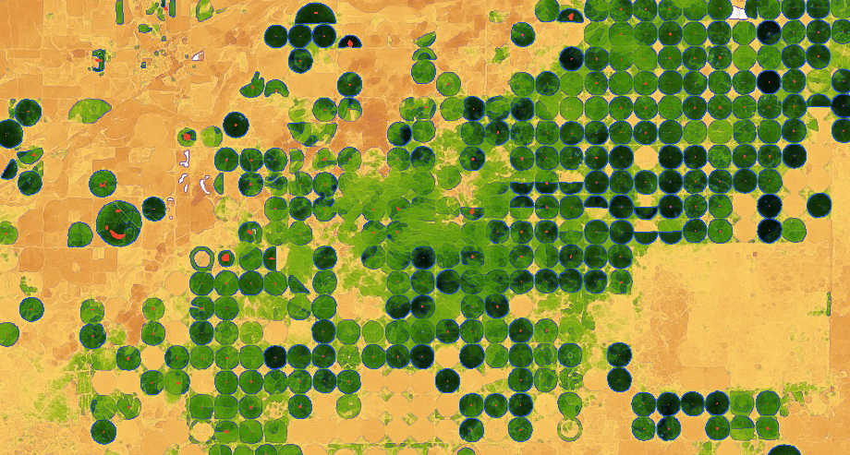
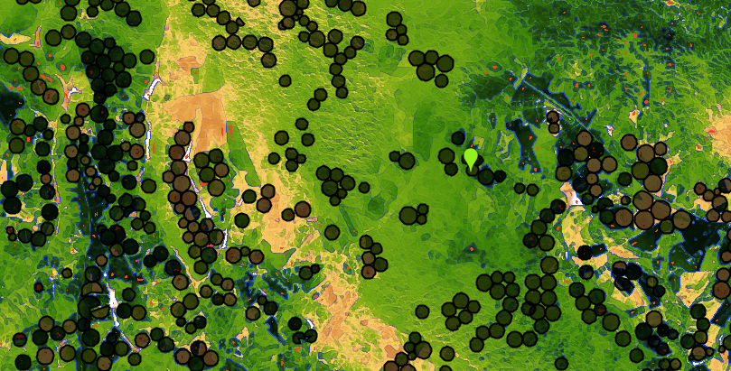
Center Pivot detection
In GEE: LandCover/Center Pivot Classification
based on edge detection. Red = ‘center pivot’. Blue = detected edge. Black circles = 2014 center pivot data
Kansas, using Landsat 8 day EVI in April 2013
Mato Grosso, using Landsat 8 day EVI in April 2013
Observations:
Mato Grosso’s center pivot timing varies dramatically across short spans (i.e. some center pivot is yellow while others are green)
Irregularly spaced center pivot and heterogeneous natural vegetation make it hard to pinpoint actual center pivot
As-is, natural vegetation is very often misclassified as center pivot because of the edges.
Size of center pivots is very uniform in Kansas but more varied in Mato Grosso, is a problem for edge detection

Slide 5
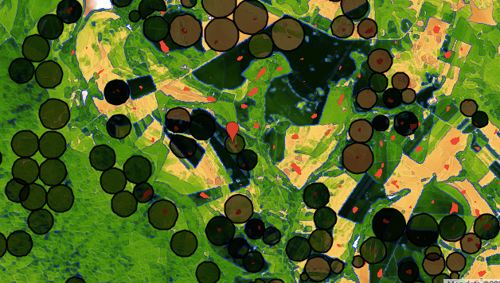
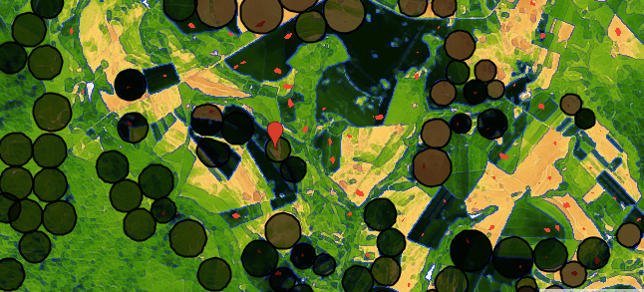
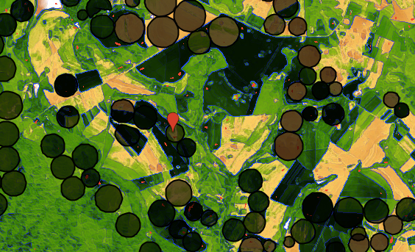
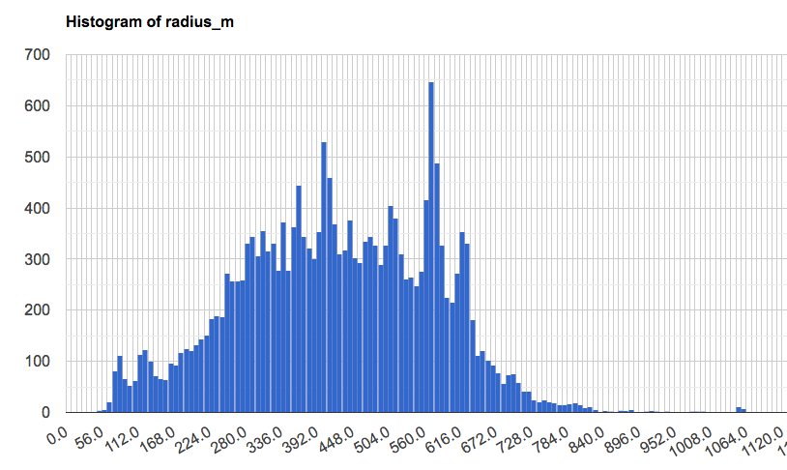
Center Pivot detection: sensitivity to size of kernel
In GEE: LandCover/Center Pivot Classification
Radius = 780m
Kernel size = 700m
Kernel size = 500m
Radius = 350m
Kernel size = 300m
Min: 5m
Max: 1300 m
Count
Center pivot radius [m]

